Slide 1
Stipend Payment Process
George Washington University
Office of Graduate Student Assistantships and Fellowships
Rice Hall 302

Slide 2
How to: Stipends Who does what?
WHO:
The School or department staff for Stipends Fellowships funded from non-sponsored research funds and sponsored research funds. Research-related personnel complete the paperwork for Fellows funded by sponsored projects.
WHAT:
For awards that also include a fellowship stipend, complete the online Stipend form in the Stipend Management Application (SMA). Log in to the GW Portal. Go to Enterprise Systems and click on SMA. In SMA, click on Stipend Request Form.
Instructions are at SMA Training for the online tutorial through the GW Web Based-SkillPort.

Slide 3
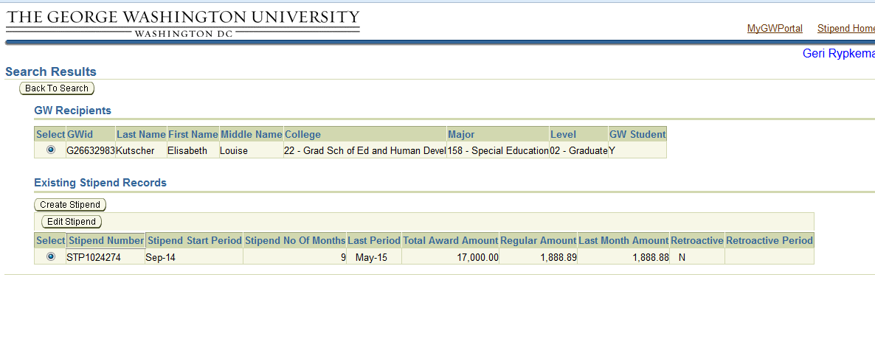
Cancellation Processes- Stipends
To cancel out the stipend go to SMA:
Go to the GW Portal and select SMA /main menu and select the stipend to be canceled

Slide 4
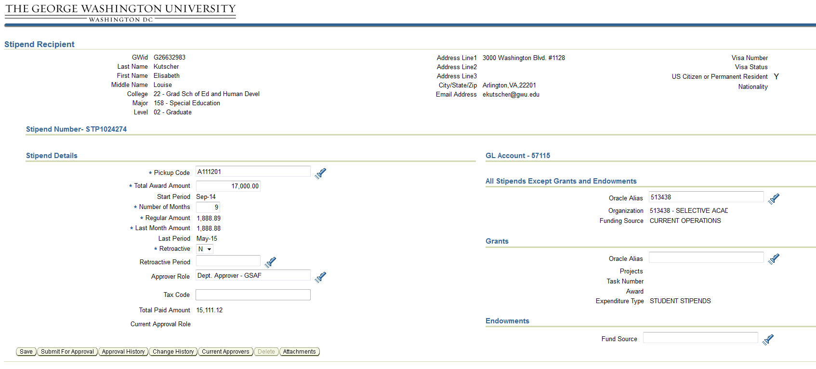
Cancellation Process-Stipends
Delete the total award amount and enter the total paid amount to cancel out the rest of the stipend.

Slide 5
Key Contacts
Questions regarding access? Any staff member who can sign into the portal
Questions regarding stipends? Send questions to gradfell@gwu.edu

